Slide 1
Metaverse
Team BlueYorkers

Slide 2
What is the Metaverse
Coined in 1992, Neal Stephenson
  A sci-fi novel Snow Crash
  Definition: an all-encompassing digital world that exists parallel to the real world
Nowadays:
  3D model of Internet, place with an avatar
  Two ways of definition by Matthew Ball
Sum up
  interactive, immersive and hyper-realistic
Notes:
When talking with metaverse, we need to trace back based on it is history. The word metaverse was founded in 1992 by author Neal Stephenson. In his science fiction novel Snow Crash, he officially defined metaverse as a digital world that covers all areas and parallel to the real world. As the time of development, its potential was discovered by technical company with huge investment involved. Metaverse is closer to public. Nowadays, we normally defined metaverse as the 3D model of recent Internet. To be more specific, each individual has a place with an avatar and interaction happens between avatars. Based on capitalist and investor Mathew Ball, he mentioned two ways of defining recent version of metaverse. First, it is based on historical development of technology. When internet and computing emerged, all interactions were text-based such as emails and messages. Afterwards, it becomes to media-based format like photos (Instagram), videos (YouTube) and so on. Next, it will evolve to 3D model of user interface and experience. Second, that us think as how mobile be widely used, it is portable and a representative of computer to make sure availability of internet all the time. Metaverse is also like mobile who is always within computer and inside the internet.
To sum up into simple way, metaverse is a share virtual place that is interactive, immersive and hyper-realistic. You have customized avatar and digital assets which stored on blockchains
https://www.vice.com/en/article/93bmyv/what-is-the-metaverse-internet-technology-vr

Slide 3
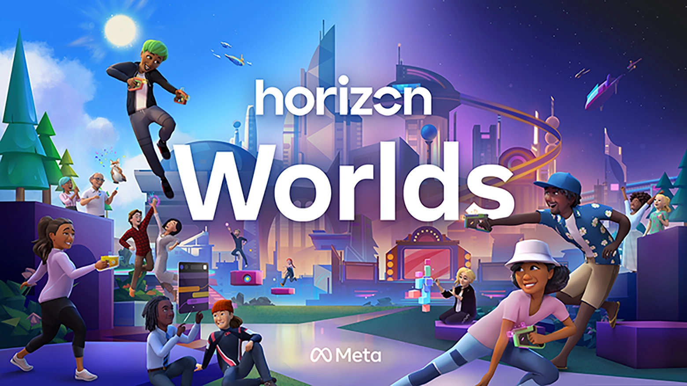
Real-world Examples of the Metaverse
Horizon Worlds (Meta)
  Created by Meta (FKA Facebook) in 2020
  Accessed through Oculus VR headsets
Fortnite (Epic Games)
  Created in 2017 as a 4-player coop game
  Gradually evolving into a metaverse
Decentraland & the Sandbox
  Fully decentralized based on the Ethereum blockchain
  NFT marketplaces offering in-game assets
  Traded in their own currencies (MANA / SAND)
Horizon Worlds, by Meta, 2021 (https://www.oculus.com/horizon-worlds/)
Notes:
(from Archie)
(Horizon Worlds:)
In the real world, Meta, formerly known as Facebook, is on its way to creating a real-world metaverse called Horizon Worlds. Users can access this virtual world through Oculus VR headsets. While in this expansive digital world, users can explore, play, create, and interact with other players. The rename of Facebook was a sign of how important Mark Zuckerberg felt the metaverse concept would be to the future of digital communications, socializing, and living.
(Fortnite:)
Fortnite is a four-player cooperative game launched in 2017, and Epic Games is continually working on making it into a metaverse. As a social network and impossible-to-ignore cultural phenomenon, Fortnite provides Epic Games a key advantage for leading in the Metaverse race.
(Decentraland & the Sandbox:)
Unlike the previous two examples, Decentraland and the Sandbox are decentralized metaverse platforms based on the Ethereum blockchain. They both have marketplaces for NFTs, offering a wide array of in-game assets and collectibles. These NFTs can also be traded via the marketplace in the platforms’ own currencies, respectively known as MANA / SAND.

Slide 4
Opportunities
Promotion
  Brands can get their name known worldwide and reach a bigger audience.
Connecting
  The virtual environment is highly interactive, thus companies can connect better to and build long-term relationships with their target audience.
Engagement
  Can create immersive and interactive experiences in the Metaverse and thus engage with people.
  Organizing virtual concerts, interviews with celebrities, different games, etc.
Selling
  Fashion clothing and accessories can be purchased online and just as in the physical world, these virtual objects signal user values and personality
Notes:
There are plenty of opportunities that can come from the metaverse, specifically ones that can benefit companies/brands.
Firstly, If your brand is on the Metaverse (especially if you are one of the first ones to be there), your name will be known worldwide and you will be able to reach a much wider audience. People will be discussing their experiences with your brand, while businesses will be discussing your strategy on the Metaverse which can help you gain visibility.
Secondly, the virtual environment is highly interactive, thus companies can connect better to and build long-term relationships with their target audience.
Thirdly, one of the most immediate opportunities for brands is to create immersive and interactive experiences in the Metaverse and thus engage with people. This could be by organizing virtual concerts, interviews with celebrities, different games, etc. In addition, you can use the Metaverse for user-generated content.
Lastly, as people spend more time online, they start valuing digital assets more and more. Not surprisingly, individuals are ready to pay a lot for virtual possessions. With NFTs and cryptocurrencies, it is easy to spend money on the Metaverse. Fashion clothing and accessories are now purchased online and just as in the physical world, these virtual objects signal user values and personality.

Slide 5
NFTs in metaverse
What are they?
  These are nonfungible tokens — tokens that are 100% unique. You can think of them as certificates of ownership that exist on the blockchain
Their role in the metaverse
  Virtual marketplace
  Art gallery
  Real estate
  … and much more
Notes:
NFTs in the metaverse.
What are NFTs? These are nonfungible tokens — tokens that are 100% unique. You can think of them as certificates of ownership that exist on the blockchain. They are created when a digital file (commonly an image, video or GIF) is minted. This means that a certificate of ownership and originality is generated via cryptocurrency (such as Bitcoin or Ethereum) and sold/granted to the new owner.
What is their role in the metaverse?
First off they can create a virtual marketplace. With apps like VRChat, spaces for communication in VR are already thriving, and it is not a huge leap to assume that these spaces can also serve as a fertile trading ground for NFTs. Sellers can easily provide links and previews to assets on the web or mint assets directly in the VR landscape.
Secondly they can function as a kind of art gallery, since VR is perhaps the best possible platform (short of an actual brick-and-mortar building) for viewing art. You get to see it up close with every detail and from every angle.
Finally, they can also be used for virtual real estate. Instead of real homes, there is digital land and territories being partially or completely sold for further user development. A real world example of this is Decentraland, a virtual territory where plots of land can be sold as NFTs, and everything is represented in 3-D. This "country" has its own cryptocurrency and is slated to enter the metaverse (make the world accessible to VR users) later in 2022.
https://www.forbes.com/sites/forbestechcouncil/2022/03/11/what-is-the-role-of-nfts-in-the-metaverse/?sh=c0f27066bb87

Slide 6

Challenges
Digital Trust
  no way of knowing who can be trusted online
  no way of distinguishing actual identities of other users
  continue to have issues we see online nowadays (ie. cyber-bullying, racism, harassment…etc.)
Digital Equity
  the reality is that half the world still does not have quality internet access though the recent pandemic has encouraged people to upgrade their peripherals
  quality of service could be significantly be affected by the quality of peripherals the users are interacting with
    For example, users from less privileged backgrounds who are not able to afford a VR headset are already excluded from the platform
Notes:
With opportunities also come challenges, the Metaverse as we know it certainly still contains a lot of uncertainty. First of all, there is the problem of Digital Trust. In the Metaverse, there is still no way of actually knowing who can be trusted online and distinguishing real identities of other users is still a tough task. On top of that, just like the internet we have nowadays, having people be able to stay anonymous creates issues like cyber-bullying, racism, harrassment…etc.
Another challenge with the Metaverse is Digital Equity. Although the recent pandemic has really allowed more people to pay more attention to their networking peripherals. We are very fortunate to be in Canada where internet access is relatively convenient and still affordable. The reality is that half the world still does not have quality internet access. Along with the Metaverse, the quality of service is also significantly affected by the quality of peripherals the users are interacting with. As you can imagine, users from less privileged backgrounds might not be able to afford a VR/AR headset. This already means they will be excluded from the platform. The internet as we know now does not quite have such a challenge as most people do have access to computers nowadays or could access it via a public resource (ie. library…etc)

Slide 7
Challenges cont’d
Privacy Issues
  already existing privacy concerns with the internet nowadays
  behaviour tracking will become more extensive and invasive
  For example, more advanced data like users’ emotions and physical reactions can be collected as well
Health Concerns
  known phenomenon called VR “hangovers”
  some people experience post-VR sadness - when they experience an amazing world in the Metaverse and have to come back into real life
  gaming addictions are already a severe problem for the younger audience - same applies for the Metaverse
Notes:
In addition, privacy issues have already been an existing concern with the internet nowadays. With more advanced peripherals like the VR headsets mentioned earlier, advertisers are able to track more extensive and invasive data. This could include behaviour tracking or even data like users’ emotions and physical reactions.
Lastly, users’ health is also another challenge of the Metaverse. There has been multiple reported cases of a known phenomenon called the VR “hangover”. This causes the user to sweat, become dizzy, have headaches, and even nausea the next day. Other people have also experience post-VR sadness. This usually happens when they experience an amazing world in the Metaverse and have to come back into real life where they realize it is nothing like the VR world they just experienced. Gaming addiction is also long been another problem even nowadays, this especially applies to the younger audience and thus becoming addicted to the VR world could also be of another huge problem for these users.

Slide 8
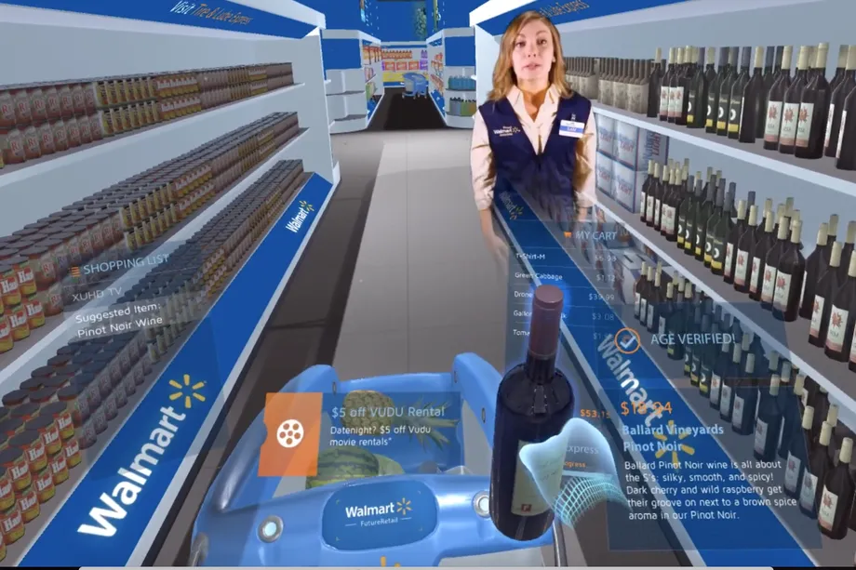
Challenges cont’d
High initial cost to enter the Metaverse
User must make an active choice to put on the headset and join the metaverse
Has to compete with more convenient devices such as smartphones and computers
Metaverse should try to make use of the 3D space, and not emulate mundane tasks
Notes:
Currently, the metaverse has a high barrier to entry, not only to purchase and setup, but also to use.
Users are required to purchase expensive equipment, connect the headset to a PC, put on the headset, start Horizon Worlds, etc. in order to use the Metaverse.
In contrast, smartphones are much less expensive to purchase, are always-on, and have become a habit for most people
This means that the Metaverse has to offer something unique that makes this high cost to the user worthwhile.
An example of where HCI fails in the Metaverse, is in emulating tasks better served through other means.
In 2017, in preparation for the South by Southwest conference, Walmart created a tech demo that shows a user shopping for groceries in the metaverse.
Although this has a uniqueness factor to it, users will find this a lot less convenient than pulling up an app on your phone and searching through a search bar.
https://www.theverge.com/tldr/2022/1/5/22868323/walmart-metaverse-shopping-video-viral-old

Slide 9
Role of HCI in the Metaverse
Smooth Start
Humanity
Accessibility & Inclusivity
Privacy & Ethical Concerns
Notes:
To begin with, good HCI guarantees Metaverse users a smooth start. UX consultant suggested that through gamification, the walk-through embellished with marvellous storytelling can instead spark people’s interest.
Another aspect that HCI helps with is humanity. In Metaverse, all users will be represented by avatars rather than just profile pictures as they are on calls. It is important to show their humanity because it enhances their immersiveness.
In addition, HCI will enhance the accessibility of Metaverse, working towards the goal that all users enjoy an equivalent experience as much as possible. Taking people with visual impairment into consideration, UX consultants would check readability in terms of colours and typographical features, and increase colour contrast, font size or weight if necessary. To render it accessible to people with hearing loss, there should be visual notifications to complement audio alerts. And for people with limited dexterity and strength, hand gestures to control should be available.
As everyone is aware, there are a few concerns about Metaverse, but we believe HCI is capable of cushioning the impacts. Consultants can help to tackle privacy concerns by devising the information-sharing system.

Slide 10
Importance of HCI in the Metaverse
Incorporating visual schemes
Streamlined and intriguing interface
Empathy and fundraising for a cause
Notes:
The Metaverse’s architecture and scheme are aided by HCI. The games and digital items must be enticing to millennials and Generation Z users. The mix of colours, iconography and visual entities should be graphically pleasing in order for consumers to dwell and actively engage in the Metaverse.
The user interface is the differentiator between 3D video games, 360-degree videos, and the Metaverse. The VR games of Metaverse combine the RPG gameplay format with an improved visual interface to provide a fully immersive experience. The audience is interested in experiencing emotions while playing the game, as opposed to being passive participants in typical video games. Metaverse’s user interface is realistic, allowing consumers to return to the platform.
Through immersive UI and UX designs in the Metaverse, non-profit organizations may evoke in their customers a sense of empathetic concern for charitable causes and societal context. It may facilitate a more engaged mentality and attitude adjustment. Stanford research has previously shown the effectiveness of VR for fund-raising, and Metaverse will take it to the next level. With the help of UI and UX applications, it will be able to solve global problems, starting a trend of buying virtual items that help

Slide 11
Citations
Sources used for Challenges:
Marr, B. (2022, April 11). 7 important problems & disadvantages of the metaverse. Bernard Marr & Co. Retrieved June 28, 2022, from https://bernardmarr.com/7-important-problems-disadvantages-of-the-metaverse/
Baveja, S. (2022, May 25). Why we must solve today's digital challenges before creating tomorrow's metaverse. World Economic Forum. Retrieved June 28, 2022, from https://www.weforum.org/agenda/2022/05/solve-digital-challenges-before-metaverse/
Poor-man's VR. VR Fitness Insider. (2018, January 2). Retrieved June 28, 2022, from https://www.vrfitnessinsider.com/avoid-cheap-vr-headset/poor-mans-vr/
Joshi, S. (2022, March 15). What is the metaverse? an explanation for people who don't get it. VICE. Retrieved June 28, 2022, from https://www.vice.com/en/article/93bmyv/what-is-the-metaverse-internet-technology-vr
The metaverse: How it can be shaped by UX designs. UX Connections. (2022, May 17). Retrieved June 28, 2022, from https://www.uxconnections.com/the-metaverse-how-it-can-be-shaped-by-ux-designs/
Bureau, P. C. Q. (n.d.). Importance of UI/UX Design in Metaverse. pcquest. Retrieved June 28, 2022, from https://www.pcquest.com/importance-uiux-design-metaverse/

Slide 12
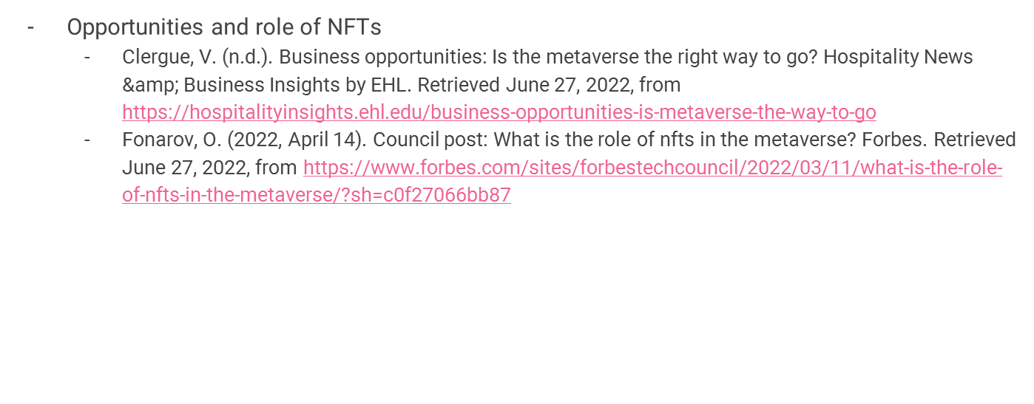
Citations

Slide 13
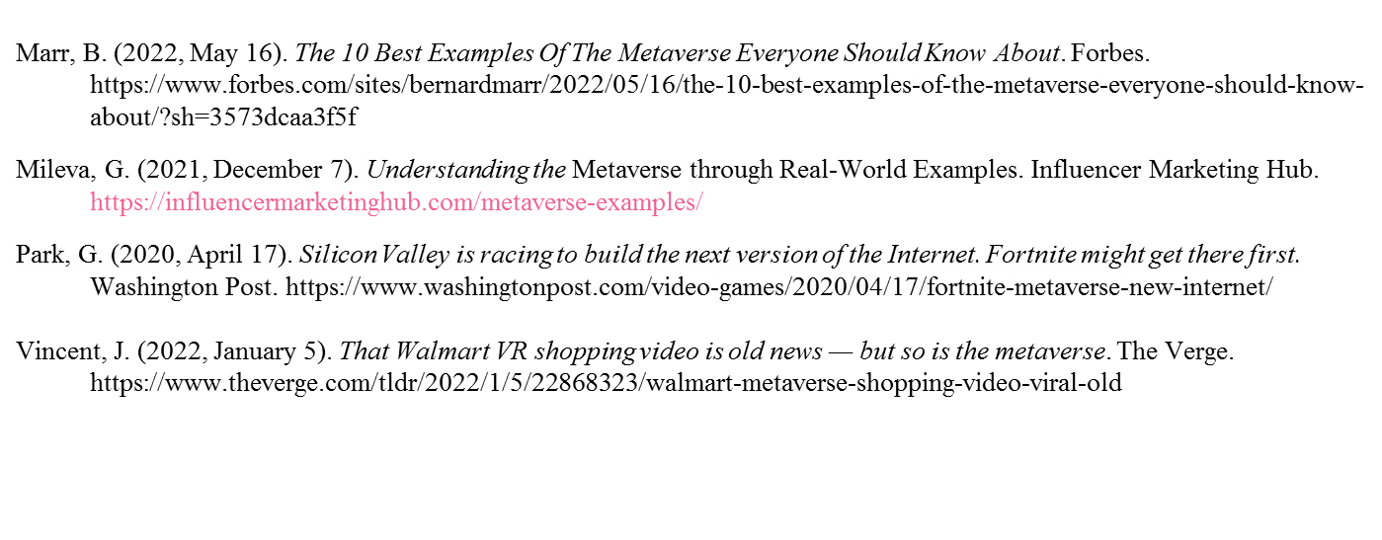
Citations

